Slide 1
Biotic Factors and Competition

Slide 2
In this Smart Lesson you will be doing the following:
1. | Clarifying that biotic factors interact with each other.
2. | Defining the term interspecific competition.
3. | Defining the term intraspecific competition.

Slide 3
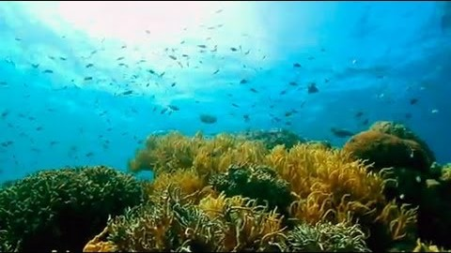

Slide 4
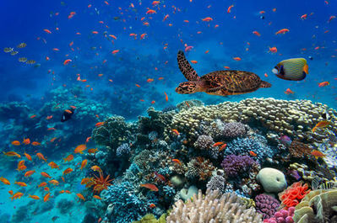
Biotic factors include the living parts of an ecosystem!
The Great Barrier Reef is home to millions of organisms. The obvious ones are fish, molluscs and turtles. It's one of the most diverse ecosystems on Earth. Even the reef itself is made of living things - did you know that sponges and corals are animals?

Slide 5
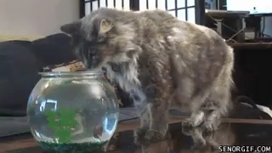
Biotic factors can interact in many ways.
One of the best known interactions between biotic factors is predation. Predation occurs when one animal (the predator) kills and eats another animal (the prey).
Sharks are very effective predators, with many adaptations for hunting other animals. Their streamlined bodies allow them to swim quietly and quickly. Their sense of smell is phenomenal and they can even detect the electricity produced by nerve cells in their prey.

Slide 6

Competition is another way that organisms interact.
You may have competitions with your friends sometimes, like an arm wrestle or a game of cricket.
In nature, competition isn't just a sport, it can be a life and death matter. Organisms have to compete for resources like food, shelter and mating opportunities.

Slide 7

Interspecific competition occurs between members of different species.
When organisms compete, they are both trying to get the same resource, whether it be food, water or shelter. For example, a great white shark (Carcharodon carcharias) may clash with an orca (Orcinus orca) for food.

Slide 8
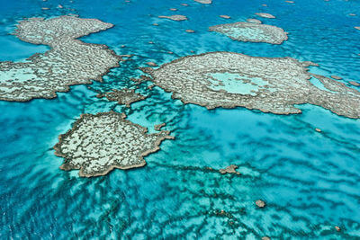
Sponges and corals look similar and are both important groups in the Great Barrier Reef.
As they grow, they actually build the reef itself, but they also get in each other's way.
Different sponge and coral species compete with each other to grow faster and reproduce more efficiently, in order to occupy more of the reef.

Slide 9
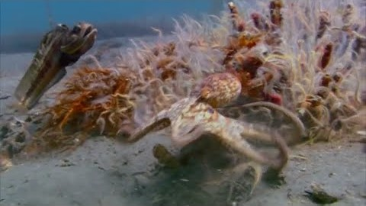

Slide 10
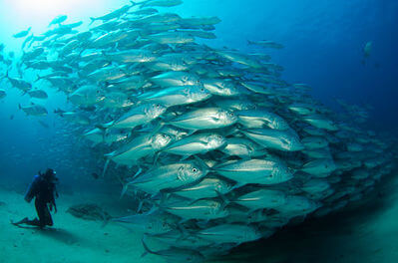
The other type of competition is intraspecific.
This is between members of the same species.
Intraspecific competition takes place within a population. 'Intra' means 'within.'
Individuals in a population may clash over territory, mates, food or other resources. When the population contains many individuals, there can be a lot of competition, like in a massive shoal of fish all living off a small reef.

Slide 11
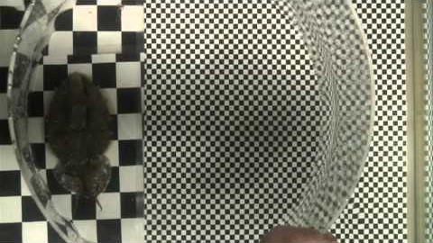

Slide 12
Members of the same species tend to require the same resources.
Luckily, intraspecific competition can be reduced, if it's harmful to the species. Some species have unusual life cycles that keep young separated from adults.
For example, frogs start out as tadpoles, which live in ponds and eat algae. Then they develop into land-living adult frogs and eat insects.

